Slide 1

8th Grade Math: Pre-Algebra
Unit 14, Lesson 2 Determining Sample Space Using Outcome Tables Volume 2, pg. 313

Slide 2


Benchmark
MA.8.DP.2.1
Determine the sample space for a repeated experiment.
volume 2, pg. 313

Slide 3
Integrated Mathematical Thinking and Reasoning Standards
MA.K12.MTR.2.1 Demonstrate understanding by representing problems in multiple ways.
MA.K12.MTR.5.1 Use patterns and structure to help understand and connect mathematical concepts.
volume 2, pg. 313

Slide 4

Learning Targets
I can determine the sample space for a repeated experiment using lists, tables, and tree diagrams.
I can determine the sample space for a two-step experiment.
volume 2, pg. 313

Slide 5

Warm-Up
volume 2, pg. 314

Slide 6

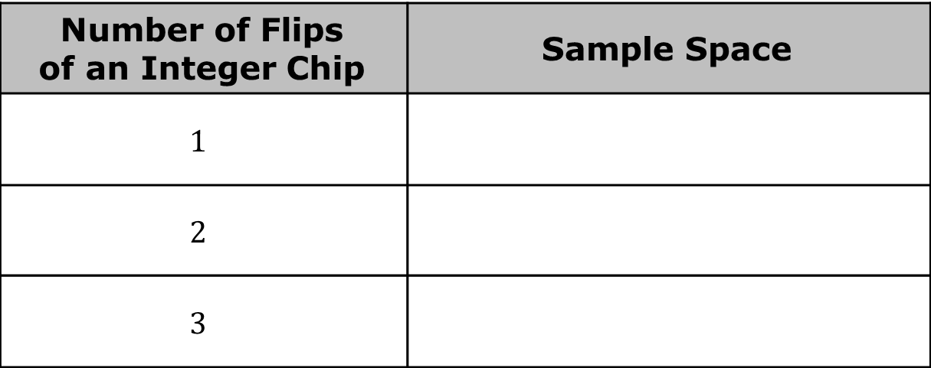
14.2.1 Warm-Up: Bell Work
The integer chips shown each have a yellow side to represent a positive integer and a red side to represent a negative integer. Complete the table for the random process below.
Number of Flips of an Integer Chip | Sample Space
$$1$$
$$2$$
$$3$$
volume 2, pg. 314

Slide 7

Collaboration
volume 2, pg. 314

Slide 8


14.2.2 Collaboration: Outcome Tables
Another way to organize the outcomes in a sample space is with an outcome table.
One limitation of an outcome table is that it cannot be used to determine the sample space of experiments with more than two steps.
Outcome tables are a useful way to list and organize all possible outcomes in a random process with two steps. They are especially useful when there are a large number of outcomes in the sample space.
volume 2, pg. 314

Slide 9
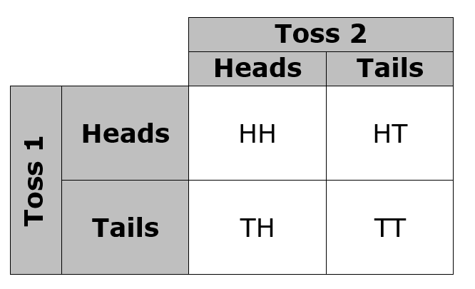
Below is an outcome table showing the possible outcomes when a coin is flipped two times.
volume 2, pg. 314

Slide 10
Since there are six possible outcomes when one standard six-sided die is rolled, the outcome table for rolling two six-sided dice needs to be six by six.
In the outcome table shown, the numbers 1-6 in the second column from the left represent the possible outcomes when the first die is rolled.
Complete the grey row to represent the possible outcomes from rolling the second die.
volume 2, pg. 315

Slide 11
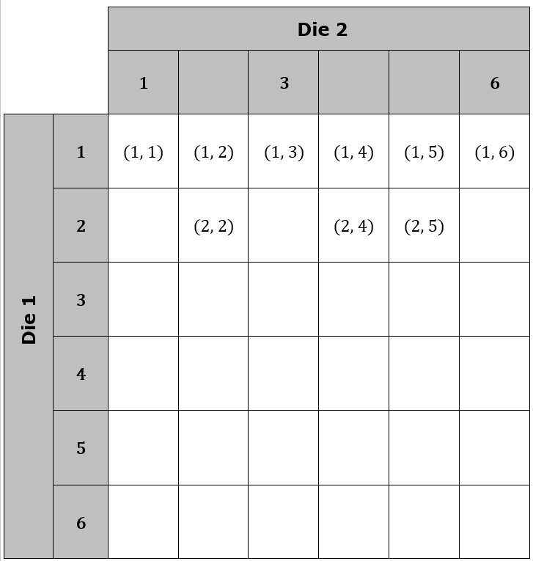
volume 2, pg. 315

Slide 12
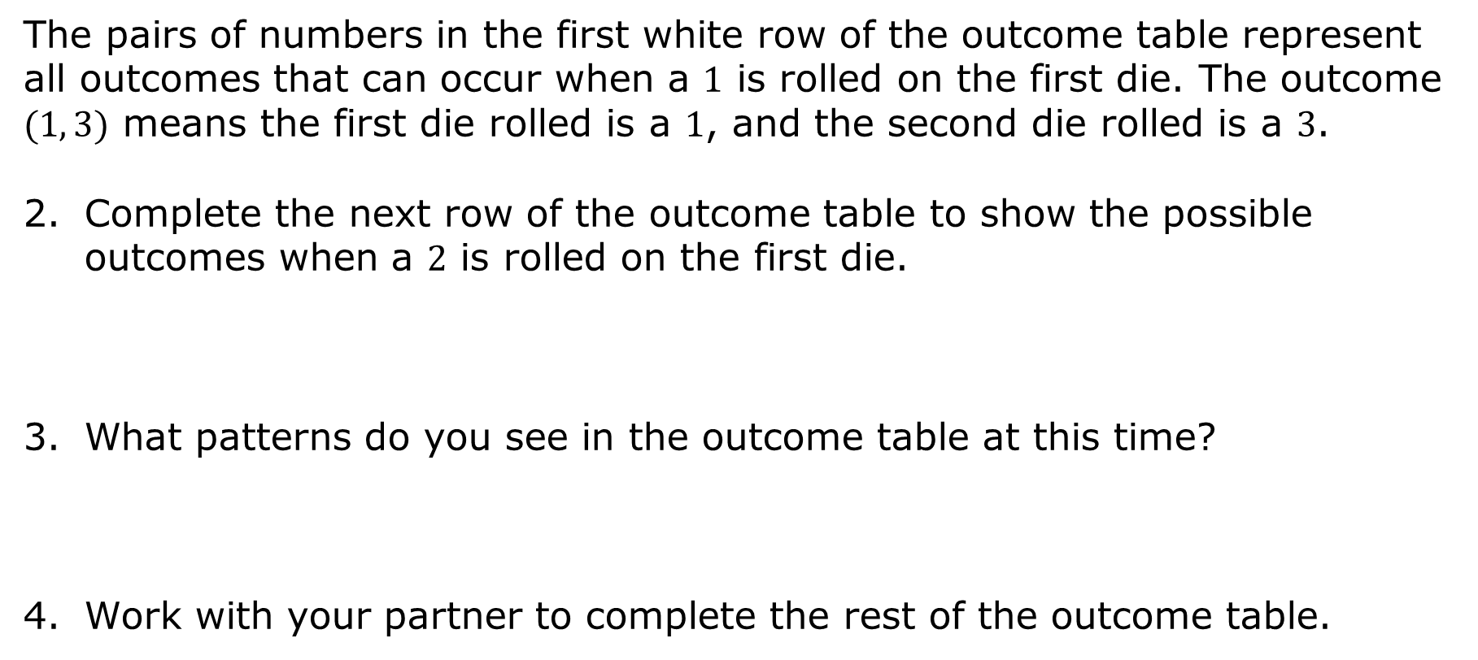
The pairs of numbers in the first white row of the outcome table represent all outcomes that can occur when a $1$ is rolled on the first die. The outcome $(1, 3)$ means the first die rolled is a $1$, and the second die rolled is a $3$.
Complete the next row of the outcome table to show the possible outcomes when a $2$ is rolled on the first die.
What patterns do you see in the outcome table at this time?
Work with your partner to complete the rest of the outcome table.
volume 2, pg. 315

Slide 13
When your outcome table is complete, find another pair of students to check your work with. Make any necessary changes.
Complete the table.
Experiment | Number of Outcomes in the First Step | Number of Outcomes in the Second Step | Total Number of Outcomes in the Sample Space
Rolling a fair die two times
volume 2, pg. 315

Slide 14
How many outcomes are in Event A = rolling the same number?
Work with your partner to complete the table showing the strengths and weaknesses/limitations of tree diagrams and outcome tables.
 | Outcome Table | Tree Diagram
Strengths
Weaknesses/ Limitations
volume 2, pg. 316

Slide 15

Guided Practice
volume 2, pg. 316

Slide 16

14.2.3 Guided Practice: Determining the Number of Outcomes in the Sample Space
A fair coin is tossed, and a fair six-sided die is rolled. Determine the sample space using either a tree diagram or an outcome table.
volume 2, pg. 316

Slide 17
Complete the table.
Work with your partner to summarize the relationship between the number of outcomes in each step of a repeated experiment and the total number of outcomes in the experiment.
Experiment | Number of Outcomes in the First Step | Number of Outcomes in the Second Step | Total Number of Outcomes in the Sample Space
Tossing a fair coin and rolling a fair die
volume 2, pg. 317

Slide 18

Bring It Together
volume 2, pg. 317

Slide 19

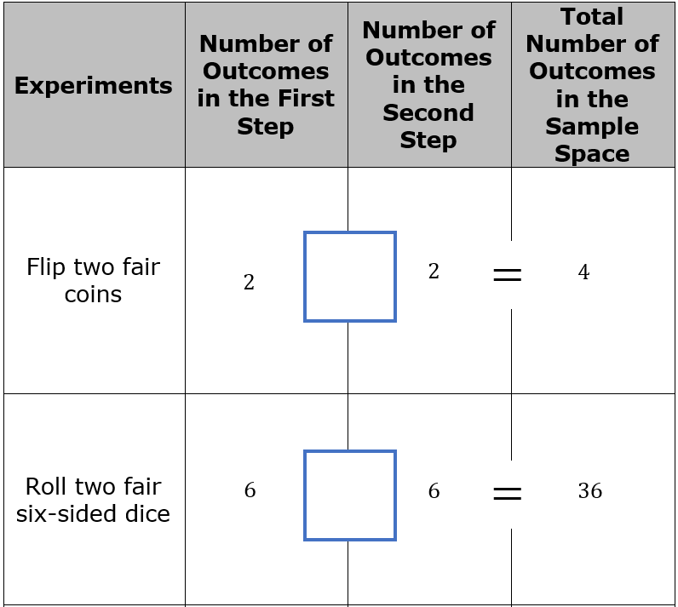
14.2.4 Bring It Together: Determining the Sample Space
Fill in the blue boxes with the same operation symbol to make all of the number sentences true.
volume 2, pg. 317

Slide 20
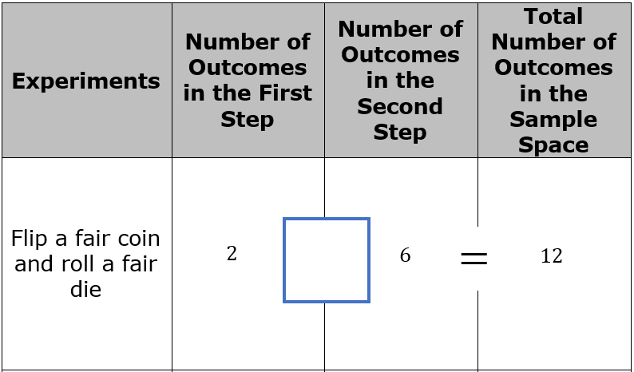
volume 2, pg. 317

Slide 21
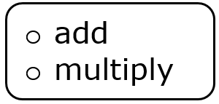
To determine the sample space for a multi-step experiment, it can be helpful to know how many total outcomes should be in the sample space. To figure this out, the number of outcomes in each step.
volume 2, pg. 318

Slide 22

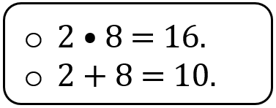
For example, if an experiment consists of flipping a fair coin and spinning a spinner with eight different outcomes, the total number of outcomes in the sample space can be found by the number of outcomes in each step of the repeated experiment. In this case,
volume 2, pg. 318

Slide 23
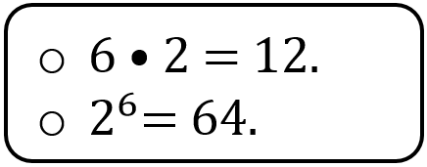
If a fair coin is tossed six times, the total number of outcomes in the sample space of this repeated experiment is
volume 2, pg. 318

Slide 24

Your Turn
volume 2, pg. 318

Slide 25
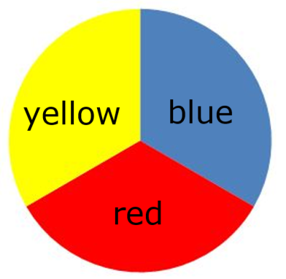
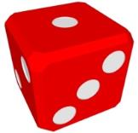
14.2.5 Your Turn!
Marianne and three friends are playing a game that requires them to spin the spinner shown, then roll a fair six-sided die on each person’s turn to play.
volume 2, pg. 318

Slide 26
How many outcomes are in the sample space when…
…the spinner is spun once?
…a fair six-sided die is rolled once?
…the spinner is spun, then a six-sided die is rolled?
volume 2, pg. 318

Slide 27
Use a tree diagram or outcome table to determine the sample space.
Write out the sample space for one player’s turn.
volume 2, pg. 319

Slide 28

Wrap-Up
volume 2, pg. 319

Slide 29
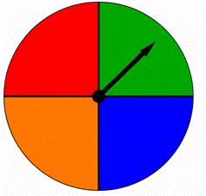
14.2.6 Wrap-Up: Ticket Out the Door
Spinner A is shown.
Spinner A
Determine the number of outcomes in the sample space when Spinner A is spun twice.
Explain which method you would choose to determine the sample space for this random process: a list, table, or tree diagram.
Write the sample space for this repeated experiment.
red
green
orange
blue
volume 2, pg. 319

